Slide 1
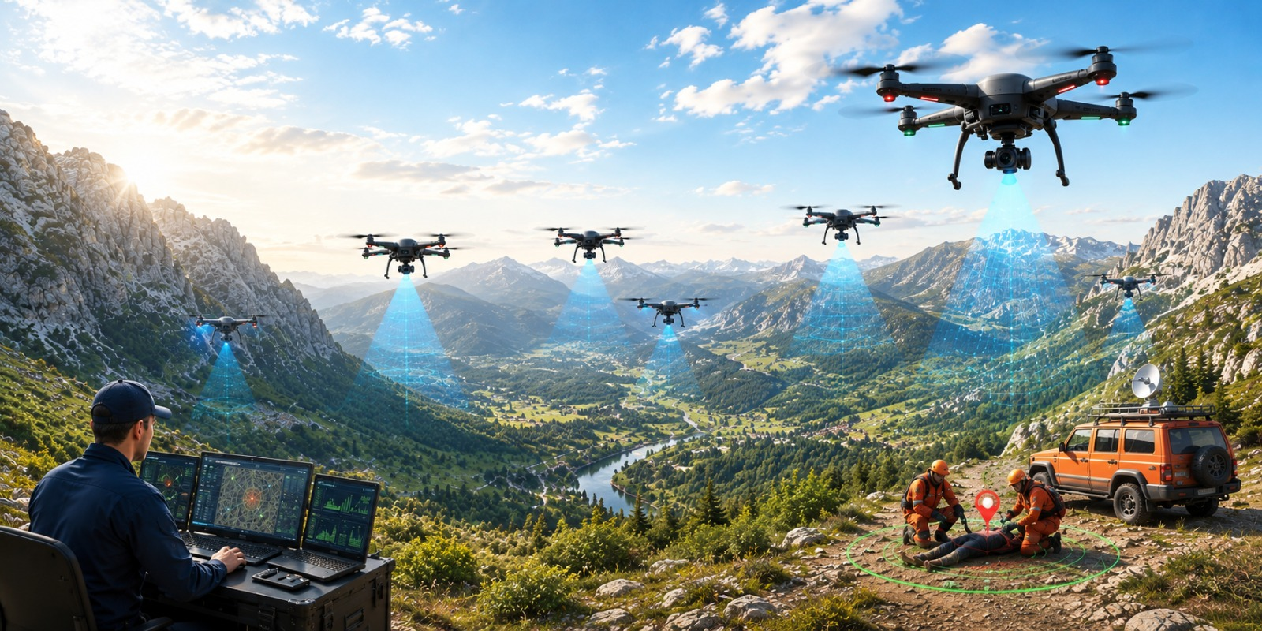
MLA0305-Reinforcement learning
MS1 Jul-Sep 2026 - SLOT B
Cooperative Drone Swarm Search and Rescue using Multi-Agent Reinforcement Learning and Swarm-Based Agent Simulation
Guided by, Dr. Vincent Gnanaraj T
Associate Professor
Department of Quantum Intelligence
SIMATS Engineering
Presented by, 192425196-P.Hithaishi
192472216-K.Sri Lasya
192525322-N.Parnita

Slide 2
Abstract
Cooperative Drone Swarm Search and Rescue using Multi-Agent Reinforcement Learning and Swarm-Based Agent Simulation proposes an intelligent drone swarm for autonomous search and rescue operations. Traditional search methods and single-drone systems suffer from limited coverage, poor coordination, and increased search time. The proposed system integrates Multi-Agent Reinforcement Learning (MARL) with swarm-based agent simulation to enable cooperative decision-making among multiple drones. The drones communicate, coordinate, and optimize their search paths to improve overall mission performance while minimizing redundant exploration. Compared with existing approaches, the proposed framework provides faster target detection, wider area coverage, improved scalability, and enhanced operational efficiency. Simulation results demonstrate better coordination, reduced search time, and higher mission success rates.

Slide 3
Introduction
Cooperative Drone Swarm Search and Rescue using Multi-Agent Reinforcement Learning and Swarm-Based Agent Simulation is an intelligent system that uses multiple autonomous drones to perform efficient search and rescue operations.
Multi-Agent Reinforcement Learning (MARL) is an AI technique in which multiple agents learn collaboratively and make intelligent decisions to achieve a common objective.
Swarm-Based Agent Simulation enables drones to coordinate, communicate, and perform tasks collectively without requiring centralized control.
The proposed system integrates MARL with swarm intelligence to enable autonomous navigation, cooperative search, and efficient task allocation among multiple drones.
Each drone shares real-time information with other drones to maximize search coverage, avoid redundant exploration, and improve overall mission performance.
Compared with conventional search methods and single-drone systems, the proposed framework provides faster target detection, better coordination, higher scalability, and improved operational efficiency.

Slide 4
Literature Survey
Author(s), Year, Journal/Proceedings | Title | Key Findings
Hickling, T., Hogan, M., Tammam, A., & Aouf, N., 2026, Journal of Field Robotics | Deep Reinforcement Learning Based Autonomous Decision-Making for Cooperative Uncrewed Aerial Vehicles: A Search and Rescue Real World Application | Developed a deep reinforcement learning framework for cooperative UAVs capable of autonomous navigation, task allocation, and victim search in real-world search-and-rescue missions.
Chen, C., Yan, S., Zhou, X., et al., 2026, Discover Robotics | Multi-stage Hierarchical Multi-Agent Reinforcement Learning for UAV-Quadruped Completing Search and Rescue | Proposed a hierarchical MARL architecture that enables UAVs and ground robots to cooperate efficiently during search-and-rescue operations with improved coordination and exploration.
Liu, M., Wei, J., & Liu, K., 2024, Drones | A Two-Stage Target Search and Tracking Method for UAV Based on Deep Reinforcement Learning | Introduced a two-stage reinforcement learning model for target search and tracking that improved navigation accuracy and target-following performance.
Sadhu, V., Sun, C., Karimian, A., Tron, R., & Pompili, D., (2024) IEEE Conference Proceedings | Aerial-Deep Search: Distributed Multi-Agent Deep Reinforcement Learning for Search Missions | Presented a distributed deep reinforcement learning framework allowing multiple UAVs to cooperate efficiently while exploring unknown environments.
Han, S., Liu, X., Zhou, M. C., et al., 2024, IEEE Internet of Things Journal | Joint Association, Deployment and Flight Trajectory Optimization for Multi-UAV Enabled Large-Scale Mobile Edge Computing | Proposed optimized UAV deployment and trajectory planning to improve communication efficiency and cooperative mission performance.

Slide 5
Literature Survey
Author(s), Year, Journal/Proceedings | Title | Key Findings
Chung, S. J., Paranjape, A. A., Dames, P., Shen, S., & Kumar, V., 2018, IEEE Robotics and Automation Magazine | A Survey on Aerial Swarm Robotics | Reviewed aerial swarm architectures, autonomous coordination, distributed control, communication methods, and future applications of UAV swarms.
Gupta, L., Jain, R., & Vaszkun, G., 2016, IEEE Access | Survey of Important Issues in UAV Communication Networks | Reviewed UAV communication technologies, swarm networking, coordination strategies, and challenges for autonomous multi-UAV systems.
Dorigo, M., Birattari, M., & Brambilla, M., 2014, Swarm Intelligence | Swarm Robotics | Explained swarm intelligence principles, decentralized coordination, collective decision-making, and cooperative behavior for multi-robot systems.
Yang, L., et al., 2014, Chinese Journal of Aeronautics | A LODBO Algorithm for Multi-UAV Search and Rescue Path Planning | Proposed an optimized path-planning algorithm that reduced travel distance and improved cooperative search efficiency for multiple UAVs.
Cao, Y. U., Fukunaga, A. S., & Kahng, A. B., 1997, Autonomous Robots | Cooperative Mobile Robotics: Antecedents and Directions | Discussed cooperative robot architectures, task allocation, distributed control, and collaboration strategies that form the basis of modern multi-agent robotic systems.

Slide 6
Research Gaps
Existing studies mainly focus on small UAV teams, providing limited support for efficient coordination and communication in large-scale cooperative drone swarms.
Most reinforcement learning models are developed for static environments and show limited adaptability to dynamic search scenarios with changing conditions.
Many existing approaches emphasize path planning or navigation individually, but do not integrate swarm-based agent simulation with multi-agent reinforcement learning.
Current multi-agent reinforcement learning techniques often require high computational resources and long training times, making real-time deployment more challenging.
Several studies evaluate only a single reinforcement learning algorithm, with limited comparison of different methods using common performance metrics such as search efficiency, reward, and execution time

Slide 7
Problem Statement
Existing search and rescue systems and single-drone approaches suffer from limited coverage, inefficient coordination, and increased search time, reducing the overall effectiveness of rescue missions.
There is a need for an intelligent cooperative drone swarm system using Multi-Agent Reinforcement Learning and swarm-based agent simulation to improve coordination, maximize search coverage, optimize path planning, and enhance search and rescue efficiency.

Slide 8
Objectives
To develop a cooperative drone swarm system using Multi-Agent Reinforcement Learning (MARL) for autonomous search and rescue operations.
To implement swarm-based coordination for efficient communication, task allocation, path planning, and maximum search area coverage among multiple drones.
To improve target detection accuracy, reduce search time, and enhance the overall efficiency and reliability of cooperative drone swarm missions.

Slide 9
The End

